Slide 1

PLEASE DELETE THIS SLIDE BEFORE PRESENTING
This PPT contains multiple slide layouts:
SLIDE LAYOUTS:
Intro Slides (4)
Logo with subtle image gallery that continuously changes in background (this will loop until you advance to next slide), can also be used as the FINAL slide for Q&A
Vision/Mission Statement
Strategic Goals
About STScI
Title Slide
Content Slides
STScI All-purpose Slide
Mission specific content slides (Hubble, JWST, WFIRST, MAST)
Section Divider Slide
Image Layout Slides
Examples of ways to neatly display one image, multiple images and oddly sized images
Chart Example
Color/font combination
In order to select the appropriate slide layout when you create a presentation, please go to the INSERT tab, select the down arrow to open the NEW SLIDE drop down menu and select the appropriate slide
Please note that you do not have to use all of the slide layouts that are provided, you may choose whichever slides are appropriate to your audience. You can also further compress the size of this presentation by selecting FILE and then selecting COMPRESS PICTURES (there are several options, Email 96dpi will be the smallest)

Slide 6
TITLE TEXT HERE
Subtitle Text Here (Optional)
Date (Optional)

Slide 7
Sample Heading
Sample text
Sample bullet
Sample bullet
Sample Bullet
Sample bullet

Slide 8
Sample Heading
Sample text
Sample bullet
Sample bullet
Sample Bullet
Sample bullet

Slide 9
Sample Heading
Sample text
Sample bullet
Sample bullet
Sample Bullet
Sample bullet

Slide 10
Sample Heading
Sample text
Sample bullet
Sample bullet
Sample Bullet
Sample bullet

Slide 11
Sample Heading
Sample text
Sample bullet
Sample bullet
Sample Bullet
Sample bullet

Slide 12
Sample Section Title Here

Slide 13
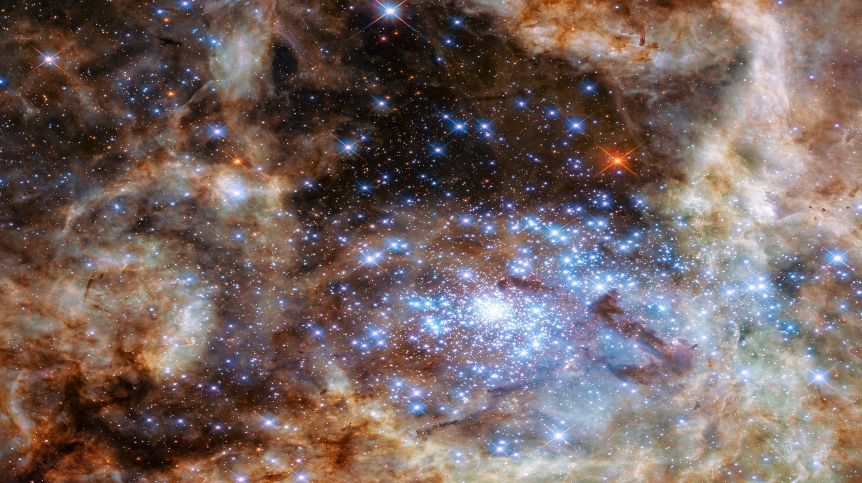
Title of Image
Caption, Description or any additional text about image

Slide 14
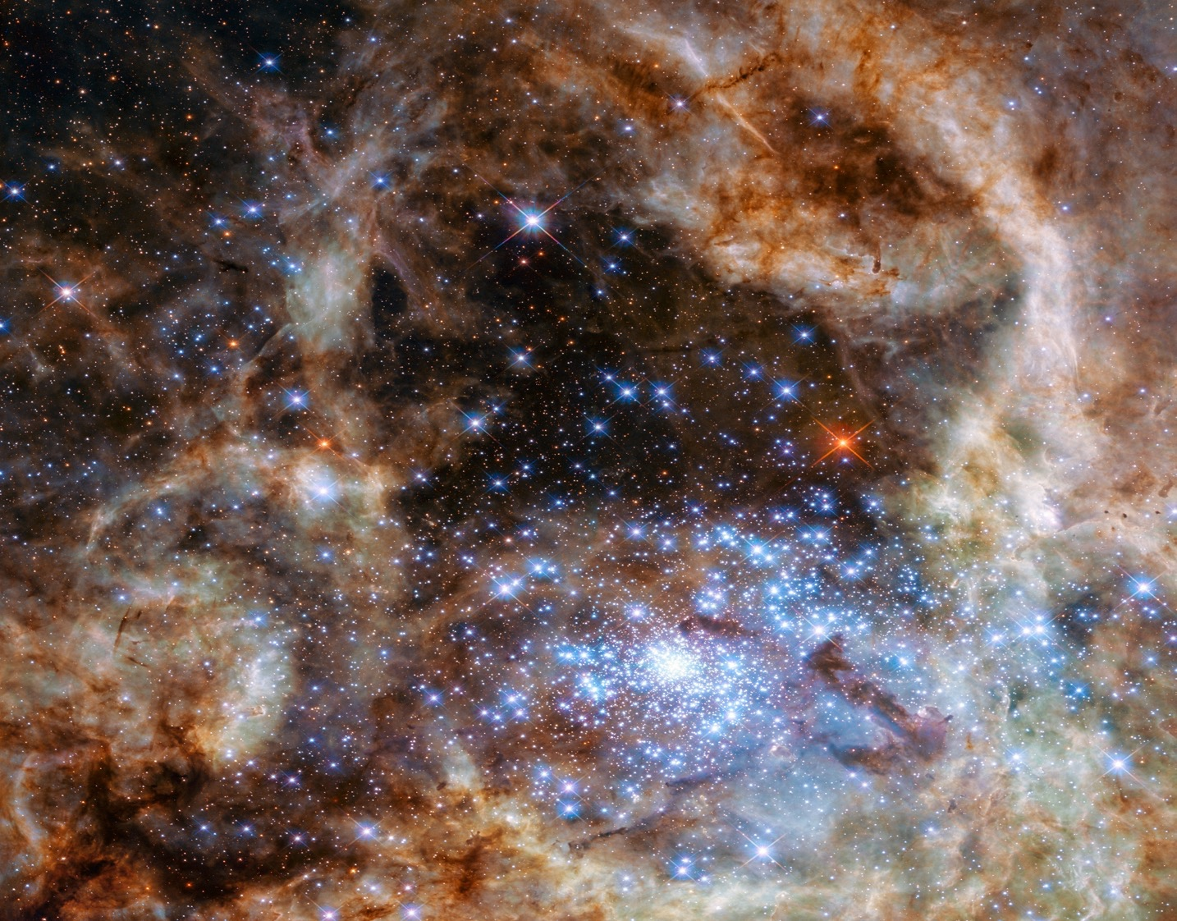
Title of Image
Caption, Description or any additional text (suitable for images that do not fit the widescreen format

Slide 15
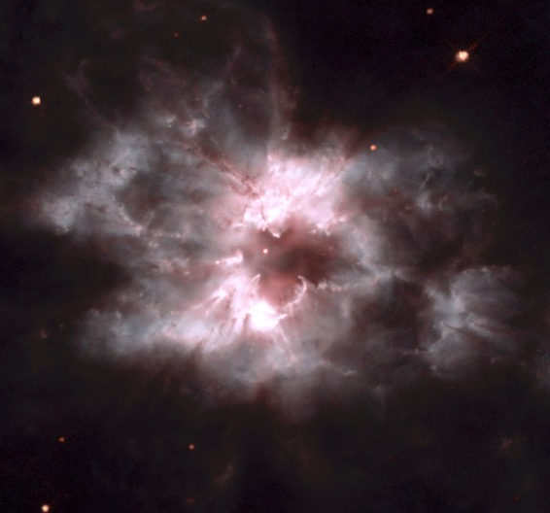

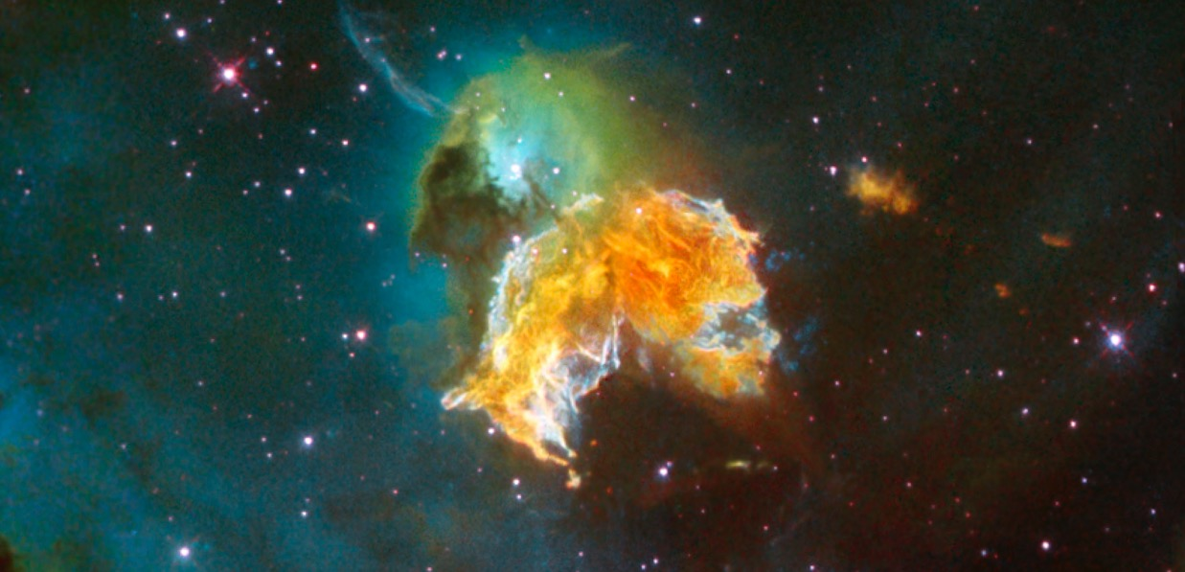
Title of Image
Caption, Description or any additional text (suitable for images that do not fit the widescreen format

Slide 16
Sample Chart Fonts/Colors
PROJECTS | LEADS | GOALS
Exoplanet Characterization Toolkit (ExoCTK) | N. Lewis & K. Stevenson | Developing seven open-source, modular data analysis packages focused on atmospheric characterization of exoplanets
Community Astronomy Software Initiative: STScI (CSI: STScI) | L. Strolger & E. Tollerud | Building and supporting an infrastructure to centralize and maintain python code for astronomical data analysis
Science Yield Optimization for Future Missions | J. Tumlinson | Developing interactive online tools for simulating astrophysics data collected from LUVOIR observations
Demonstrating Segmented-Telescope Coronagraphy by 2019 in Preparation for LUVOIR | R. Soummer | Lab astrophysics to advance technologies for coronagraph wavefront control for segmented space telescopes

